Slide 1
PRESENTATION
GOSURYA ENERGI

Slide 2
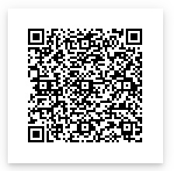
HISTORY
Go Surya Energi adalah perusahaan yang bergerak di bidang energi baru terbarukan. Berdiri sejak tahun 2020 berdasarkan Akta No. 18 Tanggal 06 Januari 2020 dibuat dihadapan Notaris Deni. S. S.H.,M.Kn. di Bandung. CV. Go Surya Energi beralamat di Jalan Soekarno Hatta, Graha Panyileukan Asri No. 26, Bandung
Go Surya Energi is a company engaged in new and renewable energy. Established since 2020 based on Deed No. 18 November 6th, 2020 made before Notary Deni. S. S.H.,M.Kn in Bandung. CV. Go Surya Energu is located at Jalan Soekarno Hatta, Graha Panyileukan Asri No. 26, Bandung
Our Location :

Slide 3
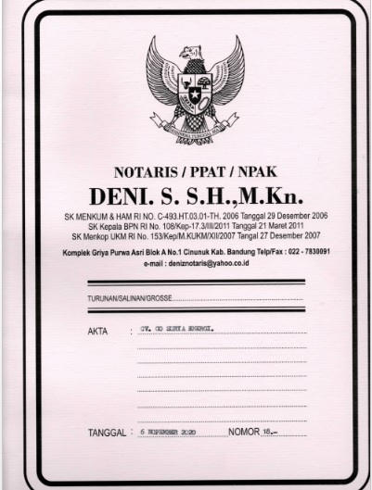
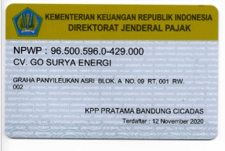
Company Certificate
NPWP – Taxpayer Identification Number
Akta Pendirian – Deed of Incorporation

Slide 4
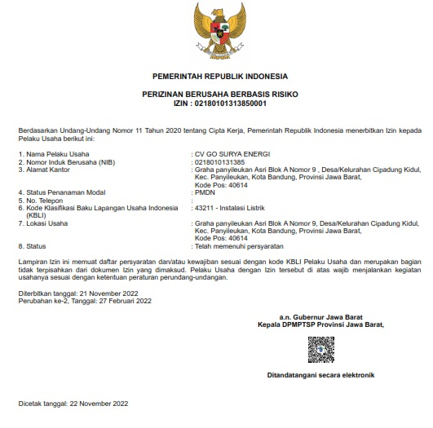
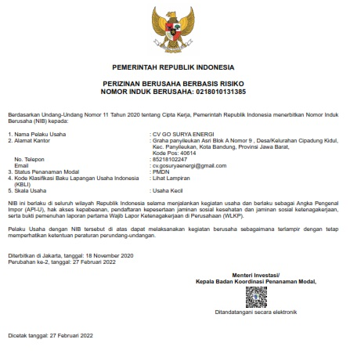
Company Certificate
IUJPTL– Business Licence of Power Supply
NIB – Business Identification Number

Slide 5
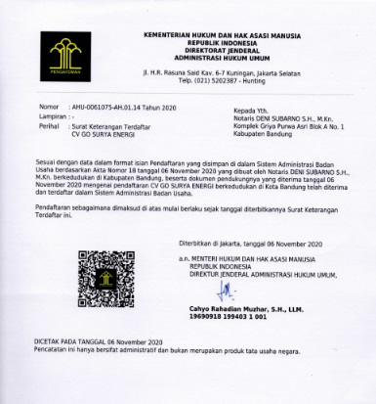
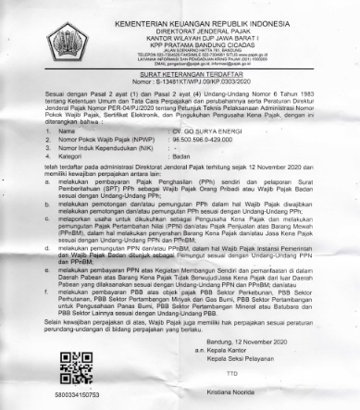
Company Certificate
SKT – Notification of Registration
Sk KemenkumHam –
Decree of the ministry of justice and human rights

Slide 6
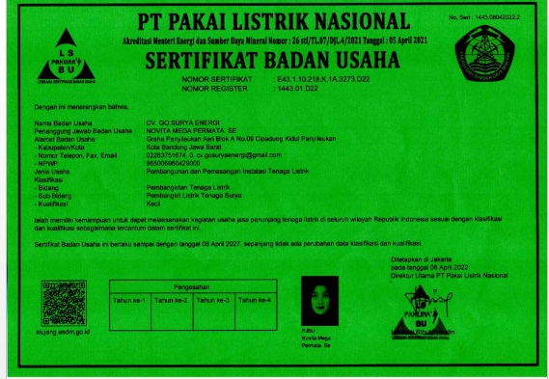
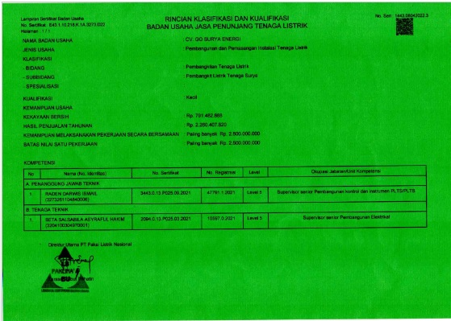
Company Certificate
SBU – Business Entity Certificate

Slide 7
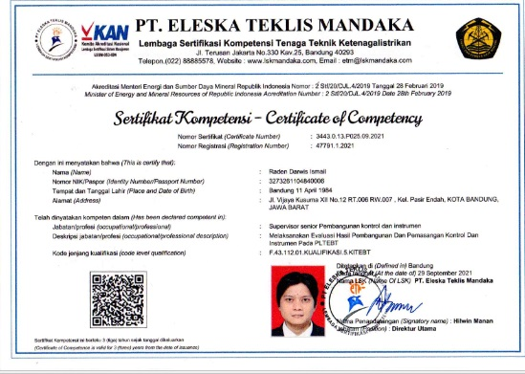
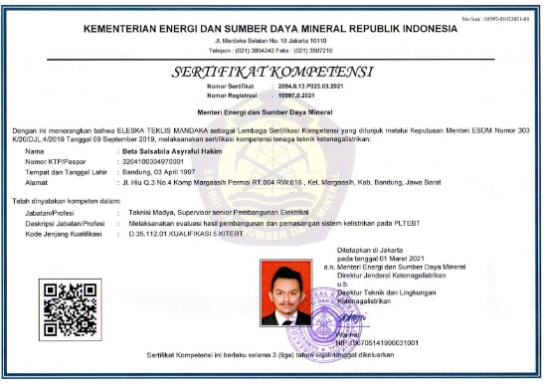
Engineer Certificate

Slide 8
Team Installation Certificate
K3 Certificate
P3K / Firstaid Certificate

Slide 9
Team Installation Certificate
TKBT Certificate / High Building

Slide 10
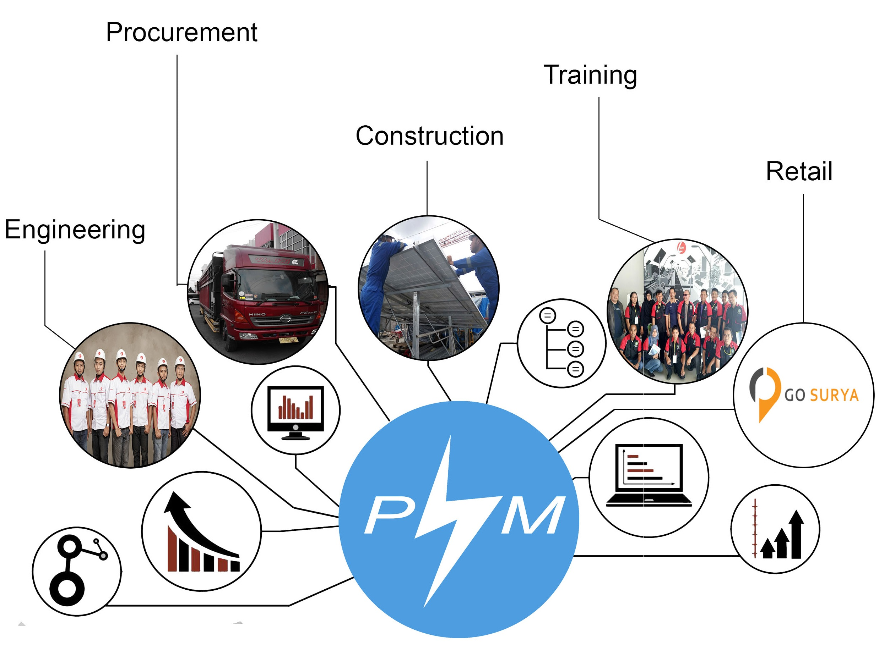
OUR SERVICE
Outsourcing
OUR SERVICE

Slide 11
Engineering
Analyze the client’s requirements and the proposed solar system
Perform a site survey to check the viability of the solar system
Determine the best structural design and maximum power generation capacity
Selecting the equipment to use and making a 3D model of the solar system

Slide 12
Procurement
Get the quality equipment from the best manufacturing companies freeing you the hassle of getting the right supplier

Slide 13
Construction
Last stage of the process, and the activity involves mounting the solar panels, accessories, and installing grid connectivity along with solar implementation in line with your existing power supply system.
After installation, we offer after-sale services like maintaining your system through equipment monitoring and maintenance.

Slide 14
Outsourcing
If client only need human resource in PV Construction Activity , we will offer outsourcing human resource , to provide human resource with skill on construction photovoltaic system.

Slide 15
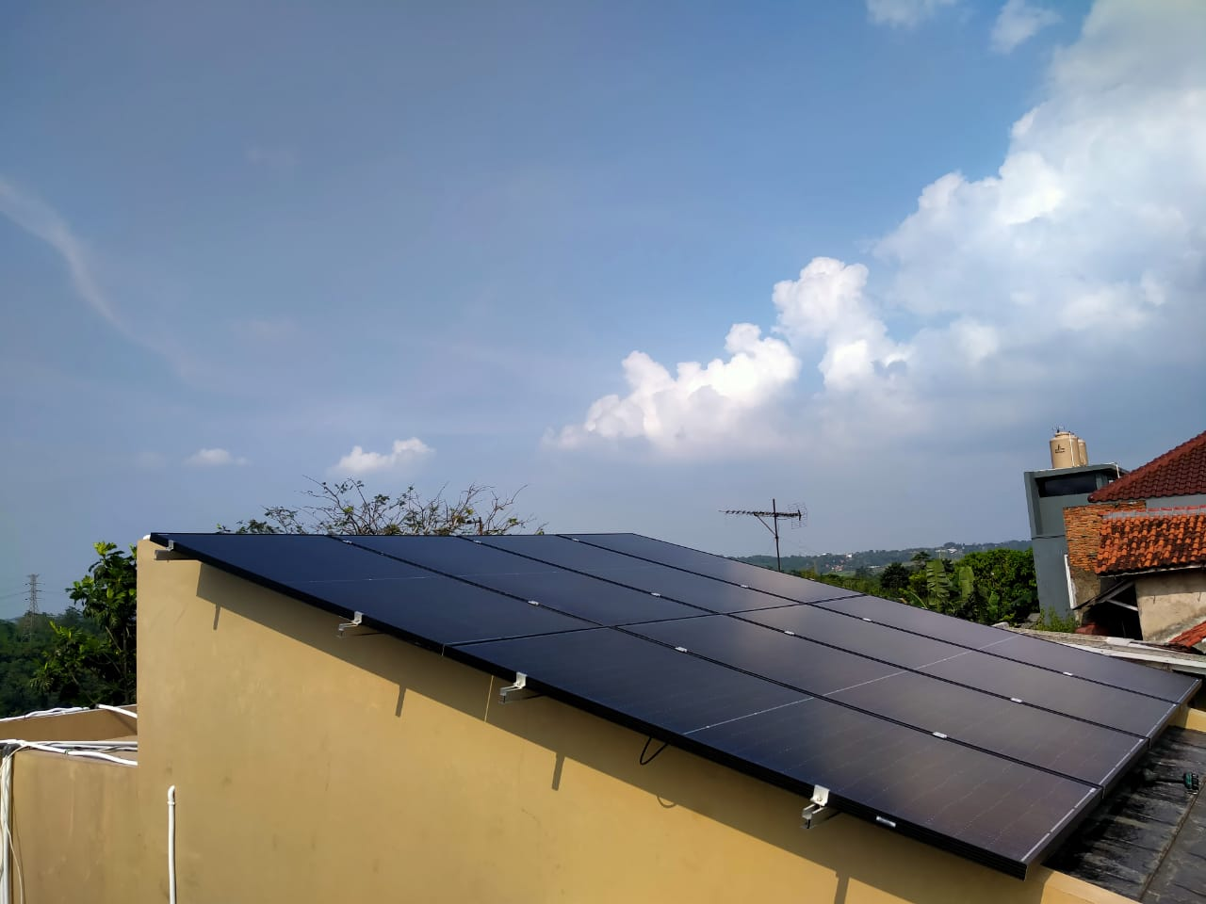
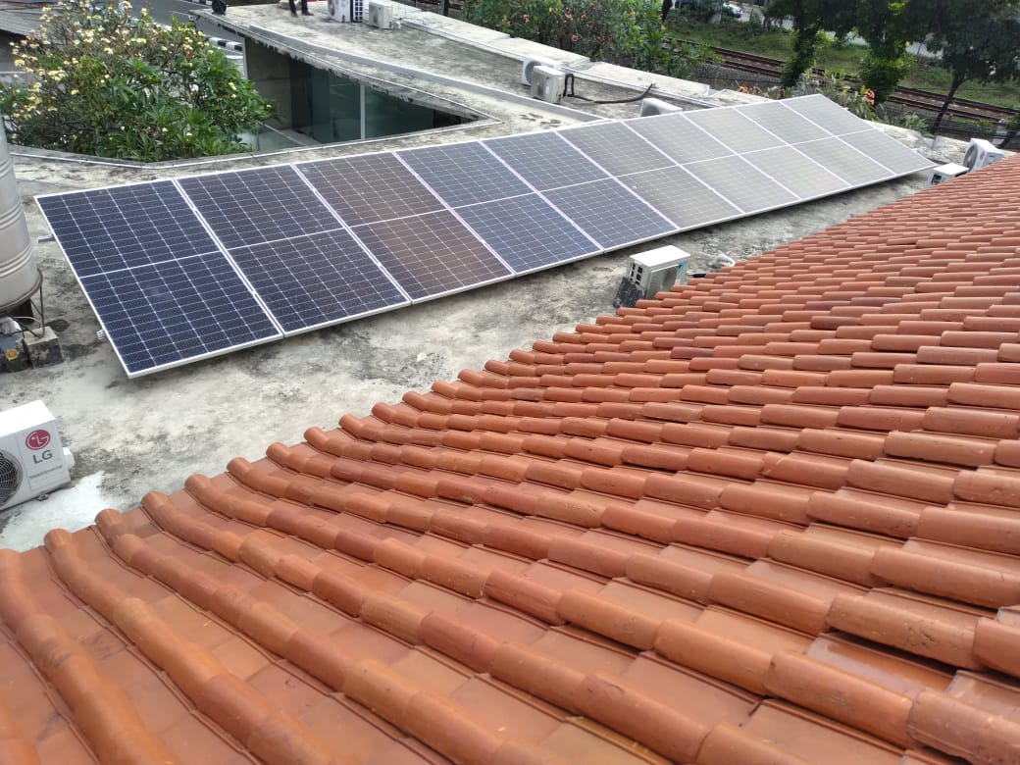
OUR PORTOFOLIO
PURWAKARTA – HYBRID 3 KWP
SOUTH JAKARTA – ON GRID 5 KWP

Slide 16
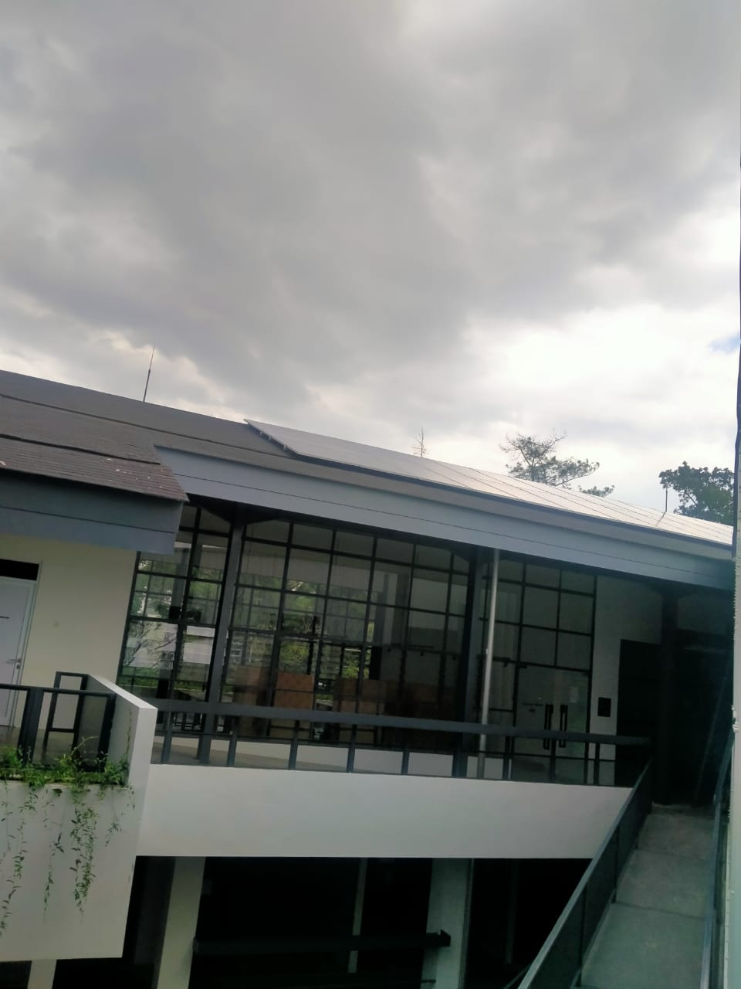
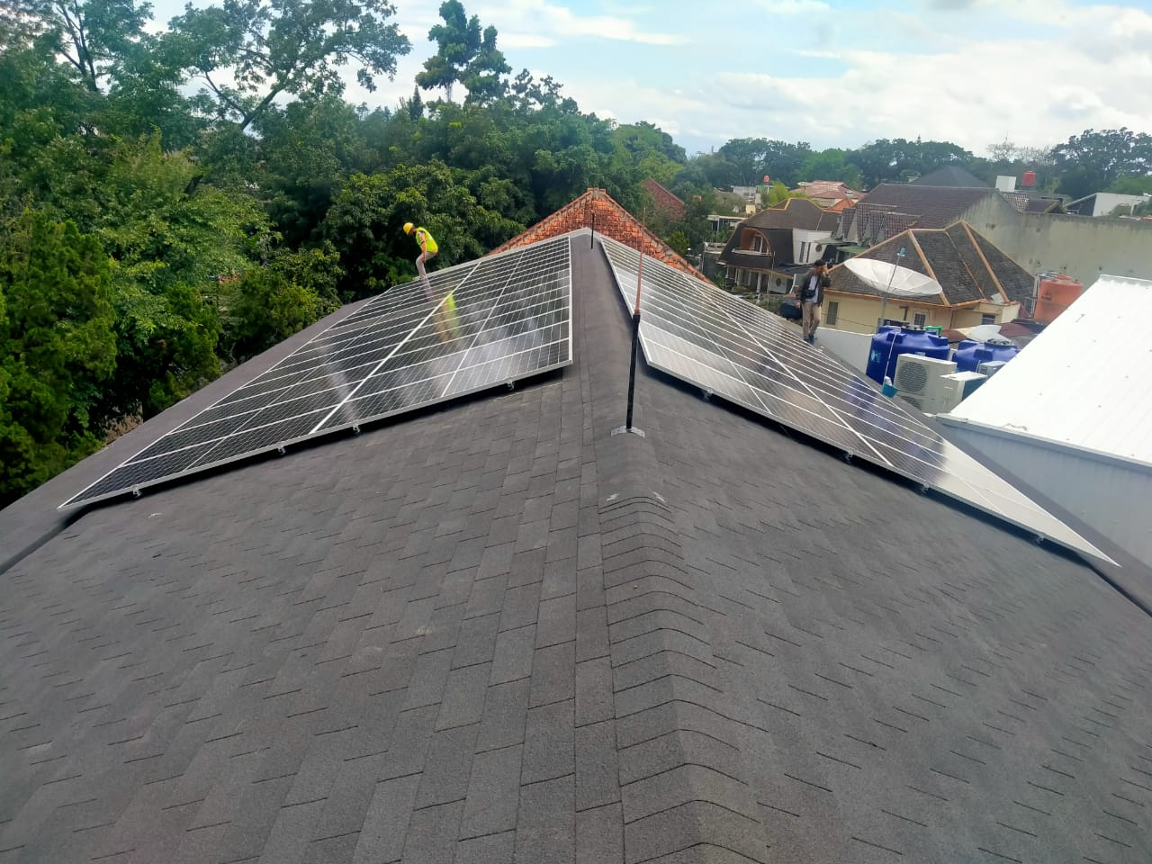
OUR PORTOFOLIO
DIPATI UKUR BANDUNG, ON GRID 23KWP

Slide 17
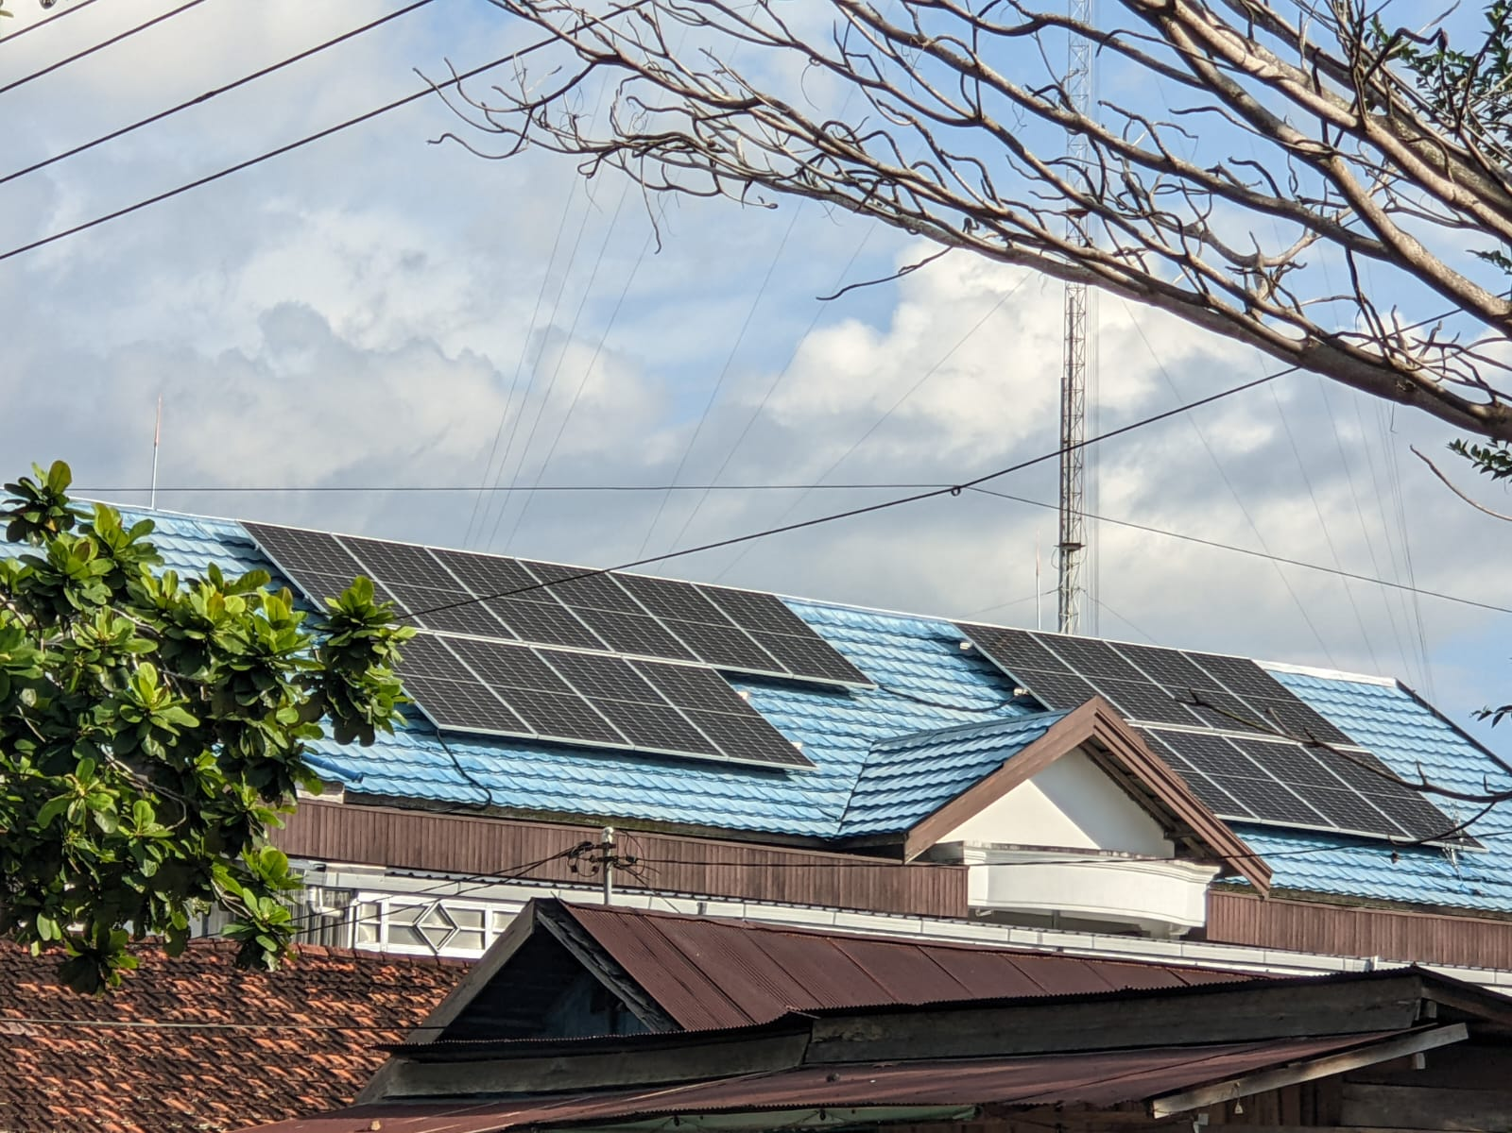
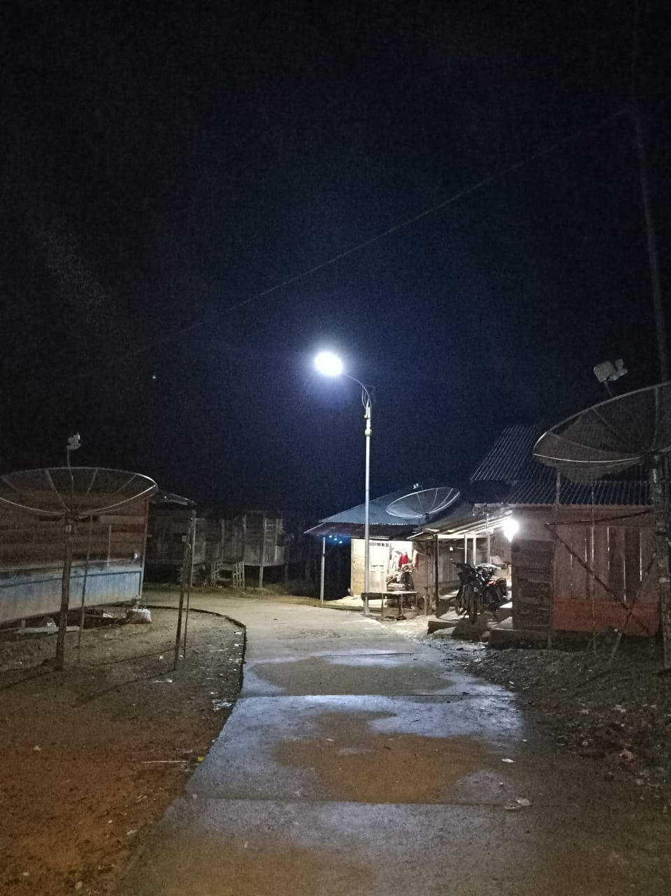
OUR PORTOFOLIO
Pangkalan Bun – ON GRID 9KWP
RIAU –
PJUTS ALL IN ONE 50 WATT

Slide 18
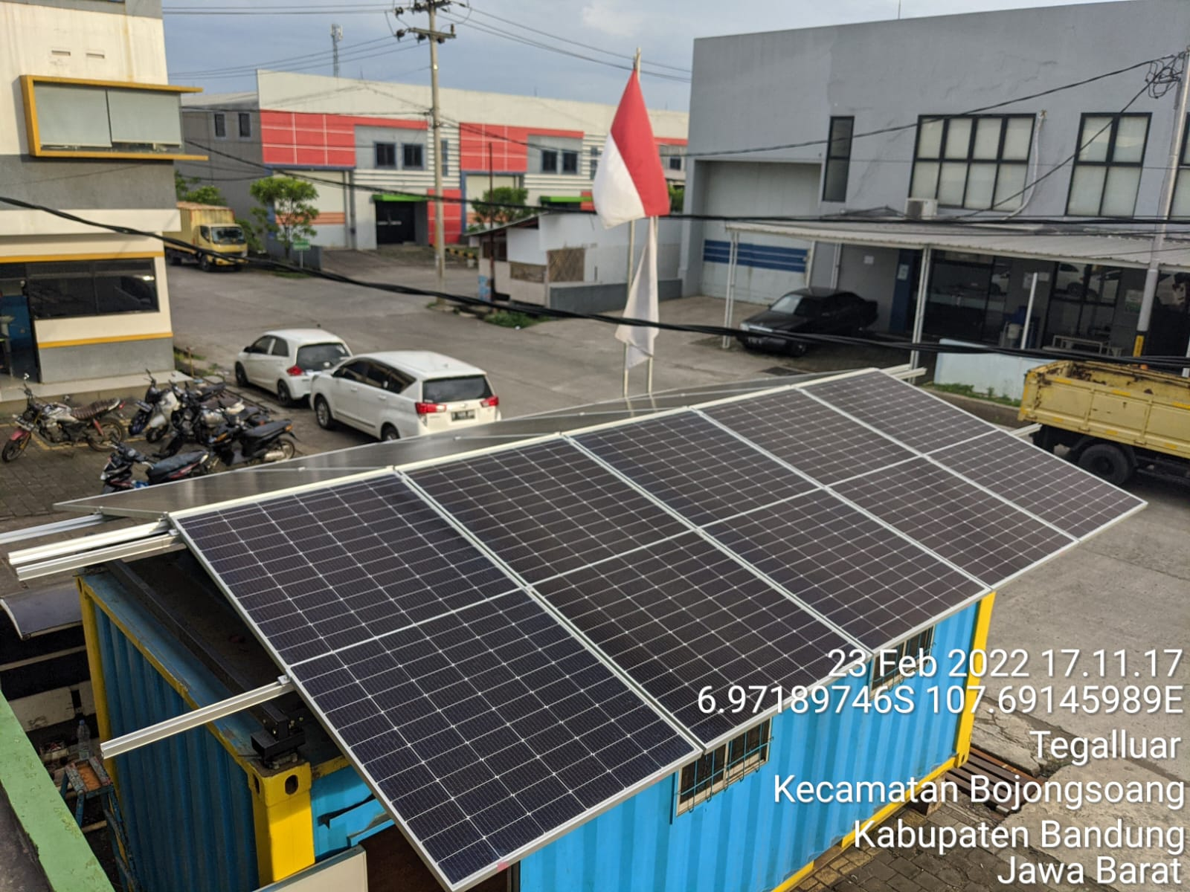
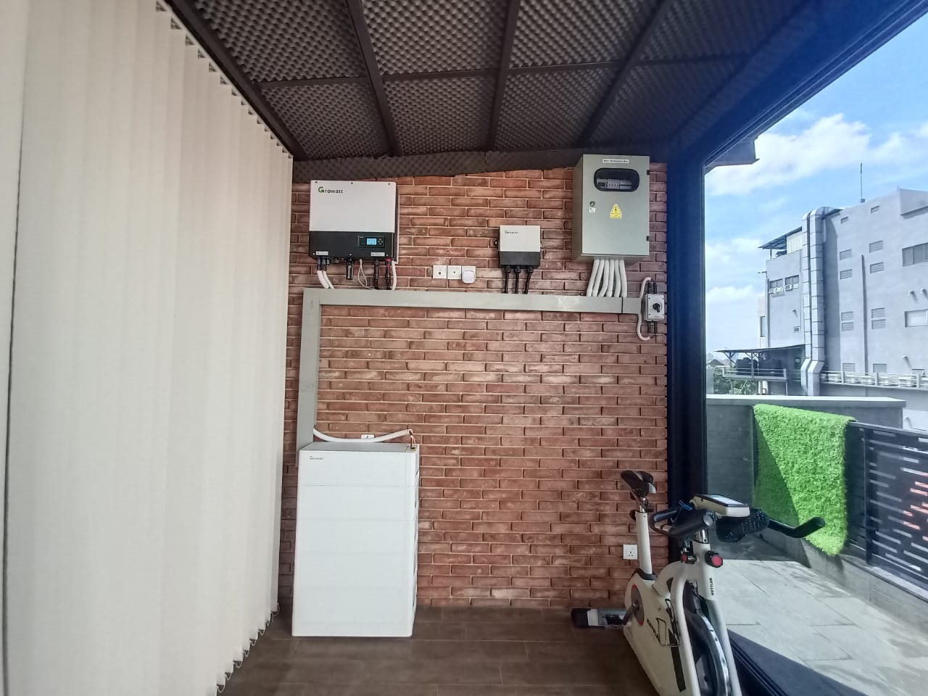
OUR PORTOFOLIO
SAPAN, BANDUNG – 5 KWP OFFGRID
KELAPA GADING – HYBRID 5 KW

Slide 19
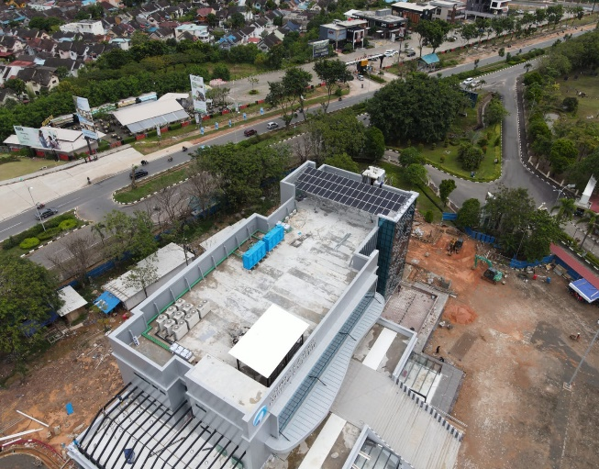
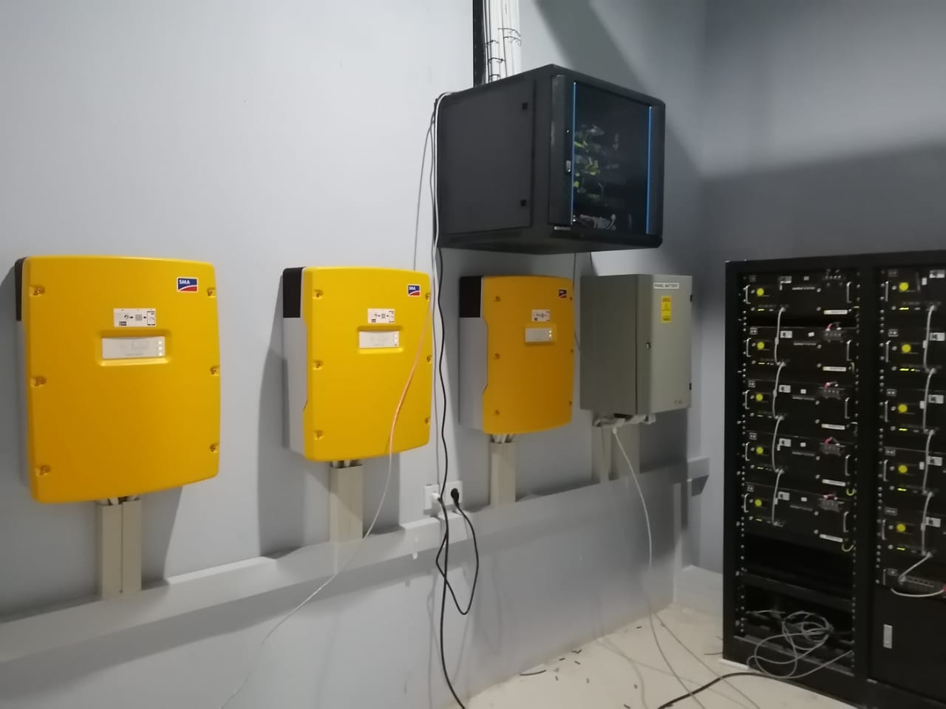
OUR PORTOFOLIO
Batam – Hybrid 17 kWp, SMA System

Slide 20
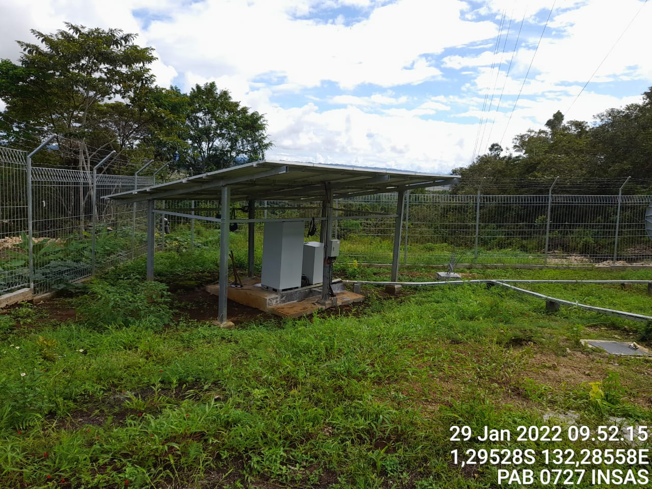
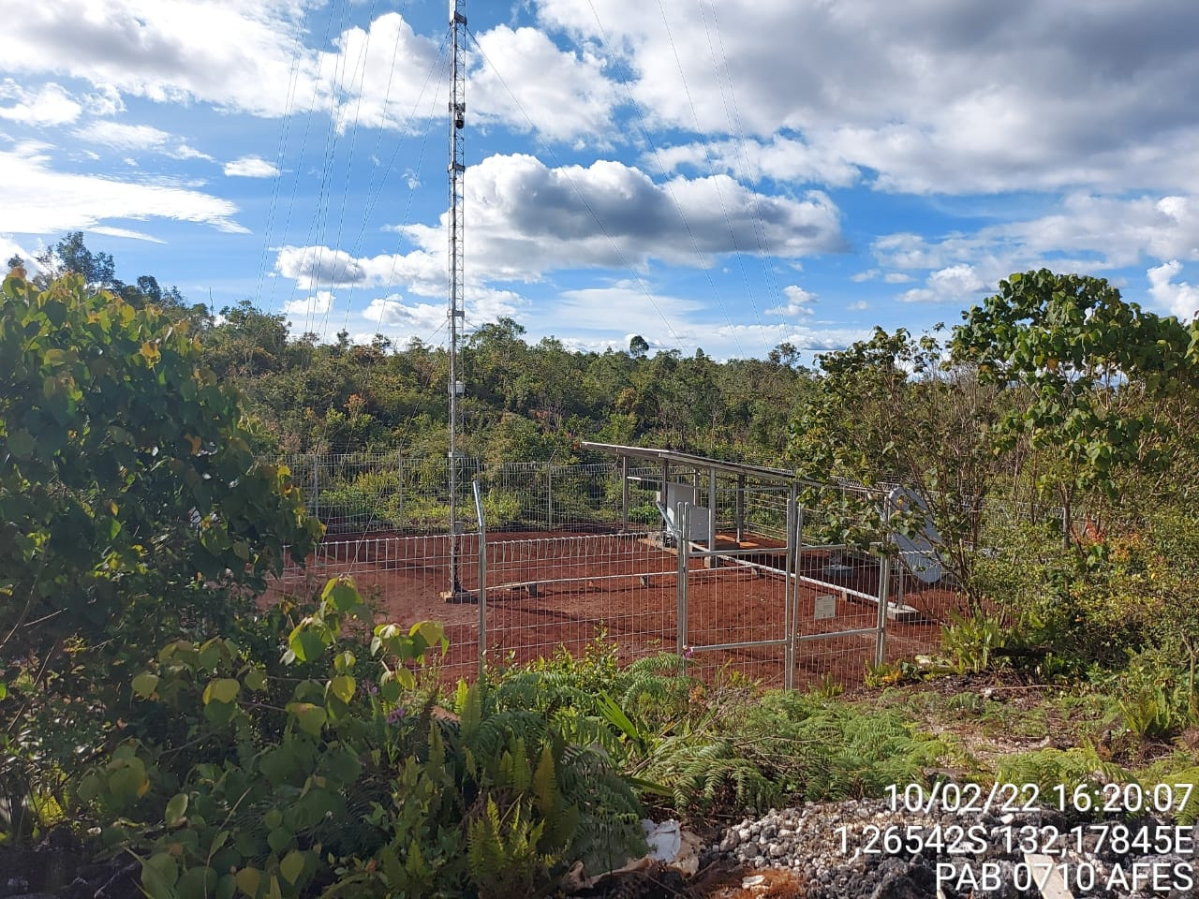
OUR PORTOFOLIO
Solar Power for BTS – Papua, Insas
Solar Power for BTS – Papua, Afes

Slide 21
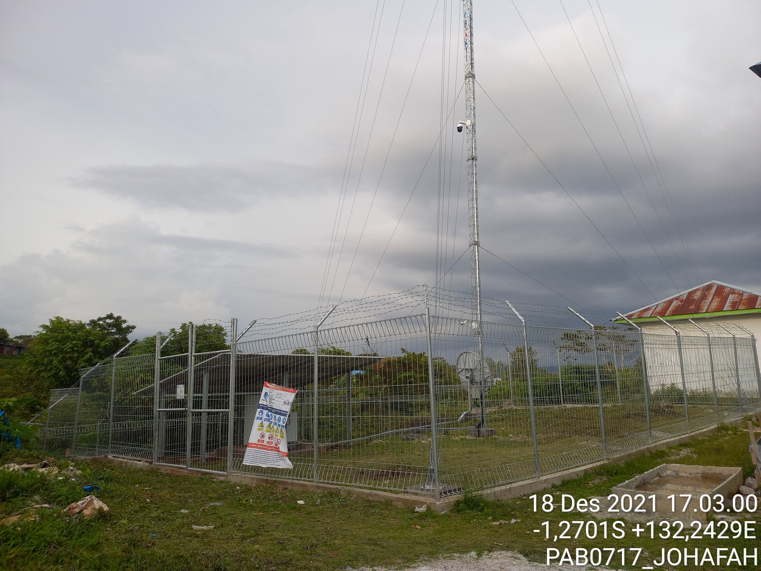
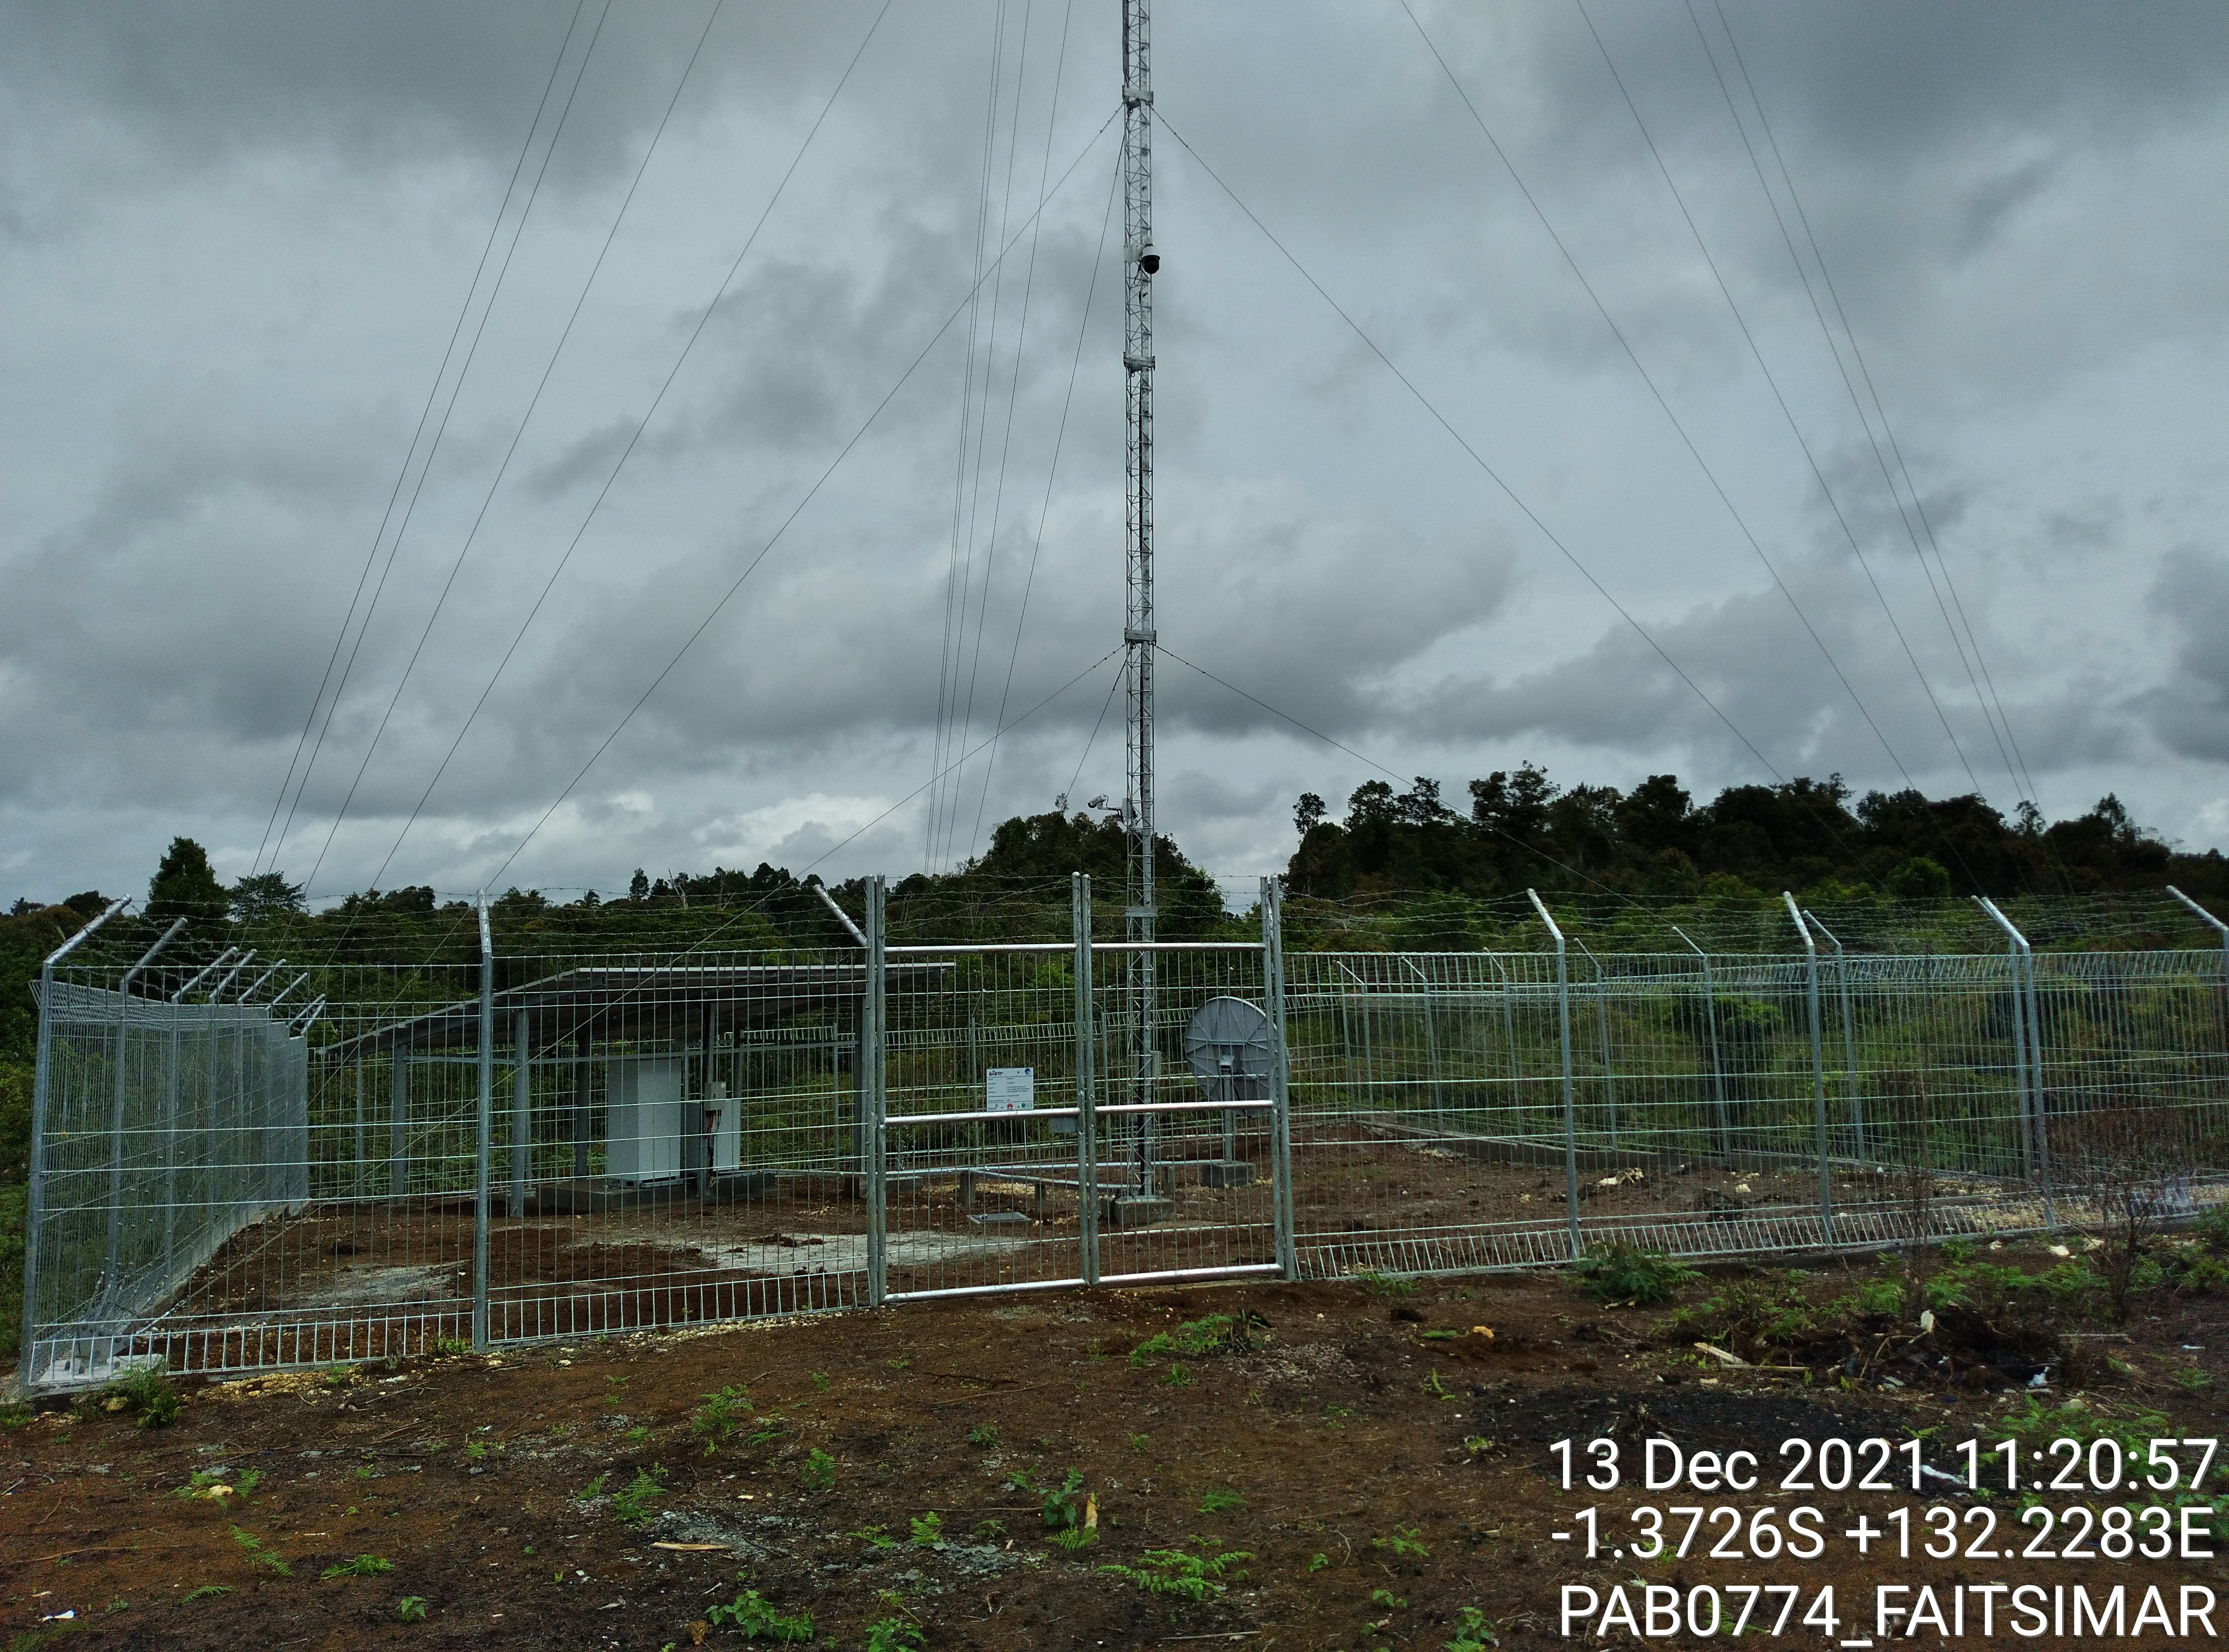
OUR PORTOFOLIO
Solar Power for BTS – Papua, Johafah
Solar Power for BTS – Papua, Faitsimar

Slide 22
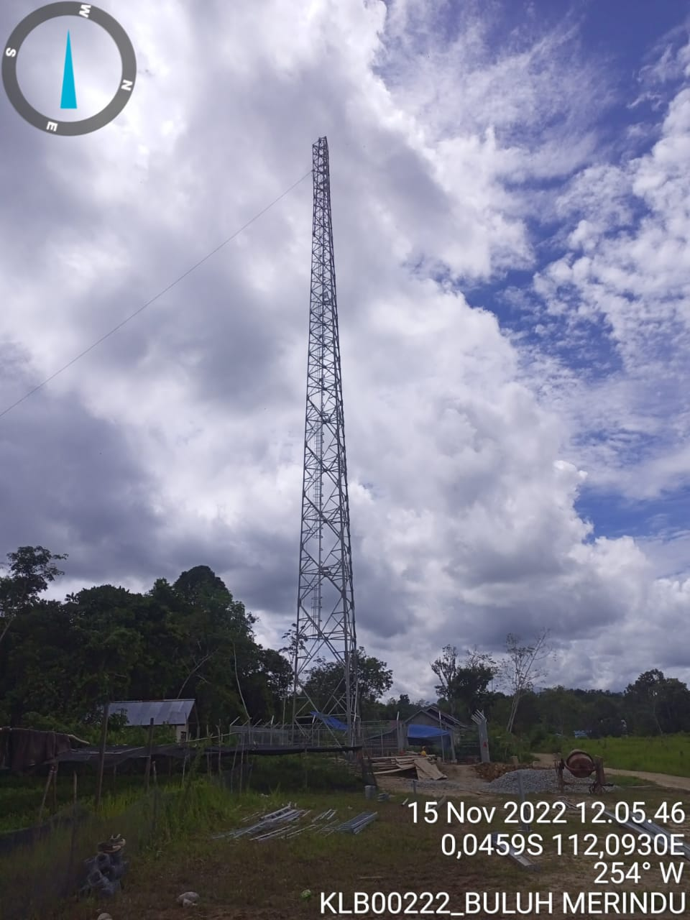
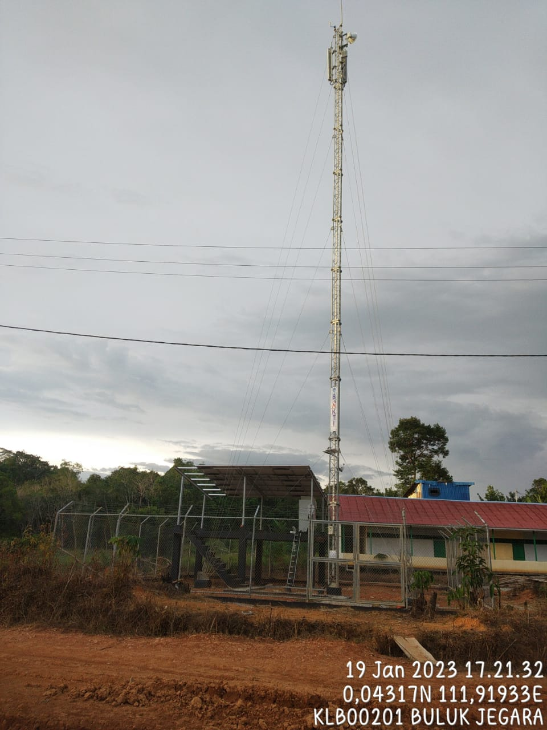
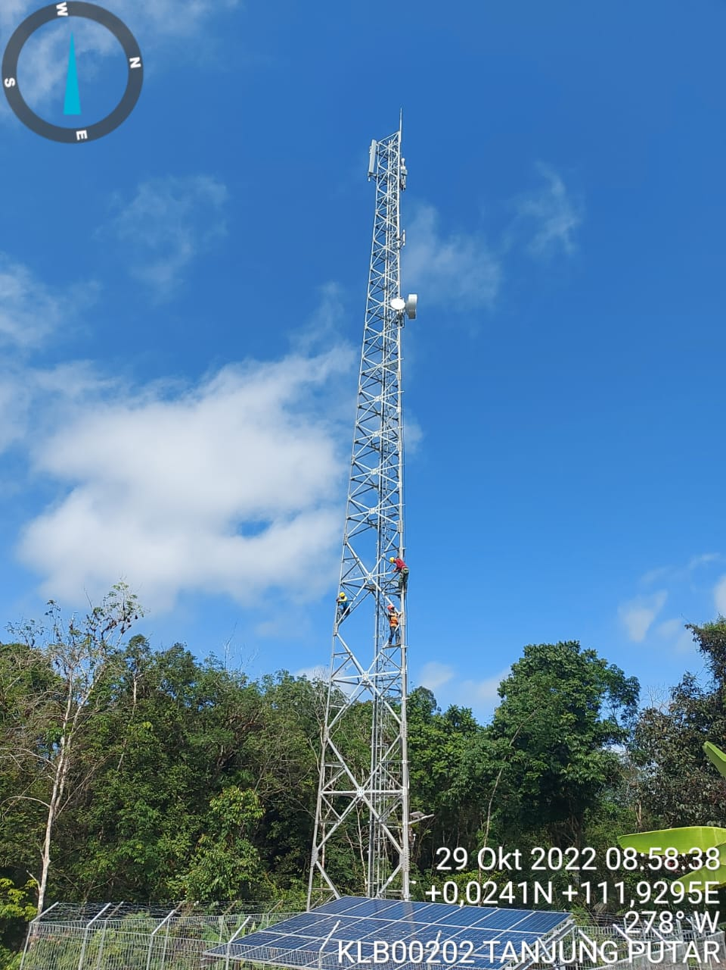
OUR PORTOFOLIO
Lokasi :
Desa Buluh Merindu
Desa Buluk Jegara
Desa Lalang Ingar
Desa Melingkat
Desa Mengkirai
Desa Pakak
Desa Sungai Buaya
Desa Sungai Sintang
Desa Tanjung Putar
Desa Tertung Mau
BTS Erection and Power – Kalimantan Tengah

Slide 23
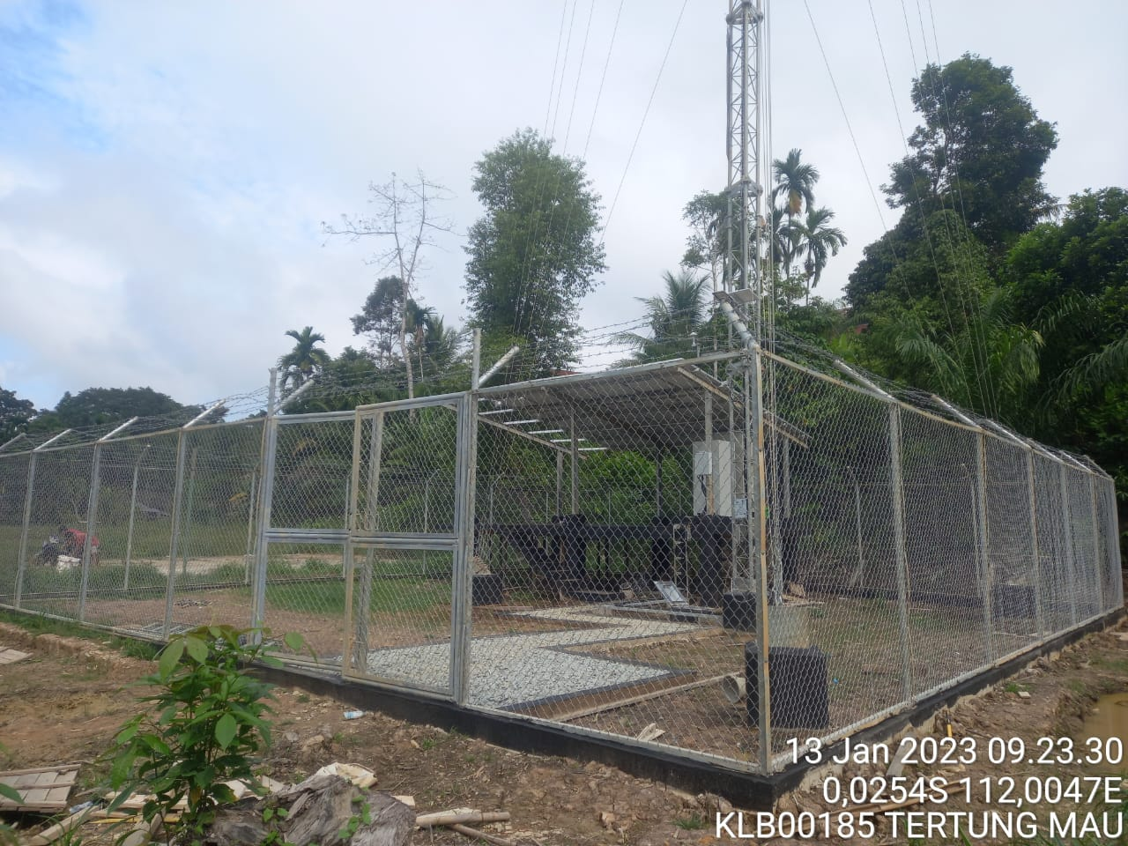
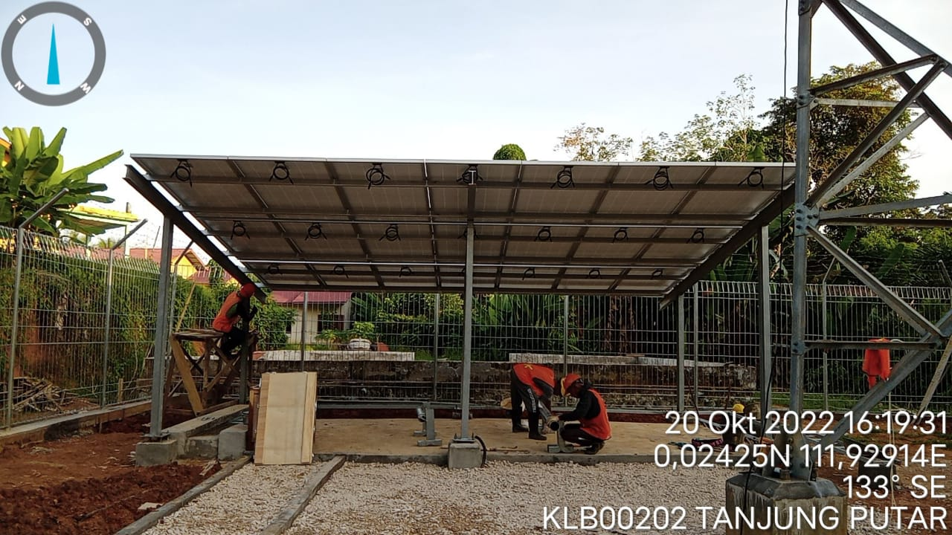
OUR PORTOFOLIO
Lokasi :
Desa Buluh Merindu
Desa Buluk Jegara
Desa Lalang Ingar
Desa Melingkat
Desa Mengkirai
Desa Pakak
Desa Sungai Buaya
Desa Sungai Sintang
Desa Tanjung Putar
Desa Tertung Mau
BTS Erection and Power – Kalimantan Tengah

Slide 24
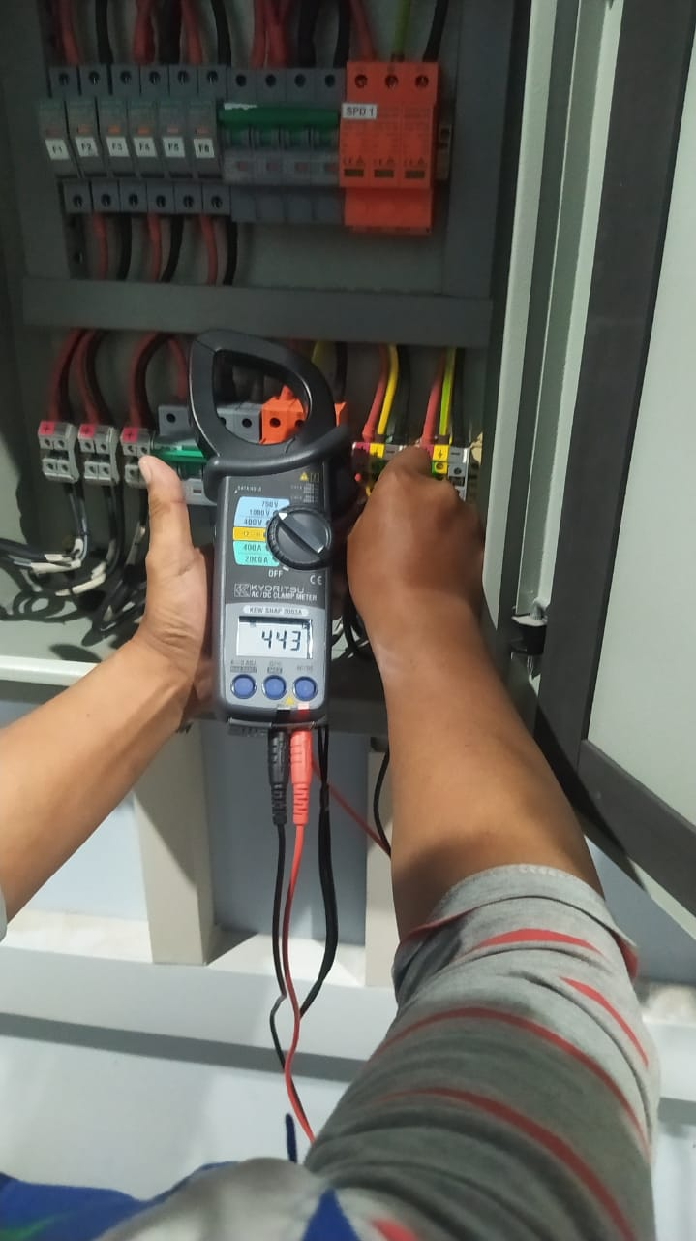
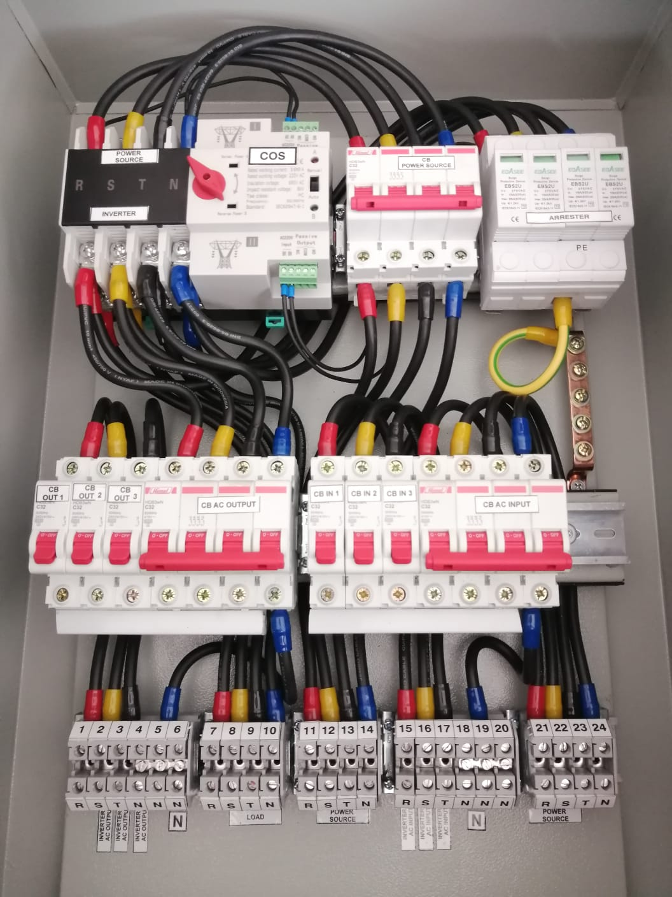
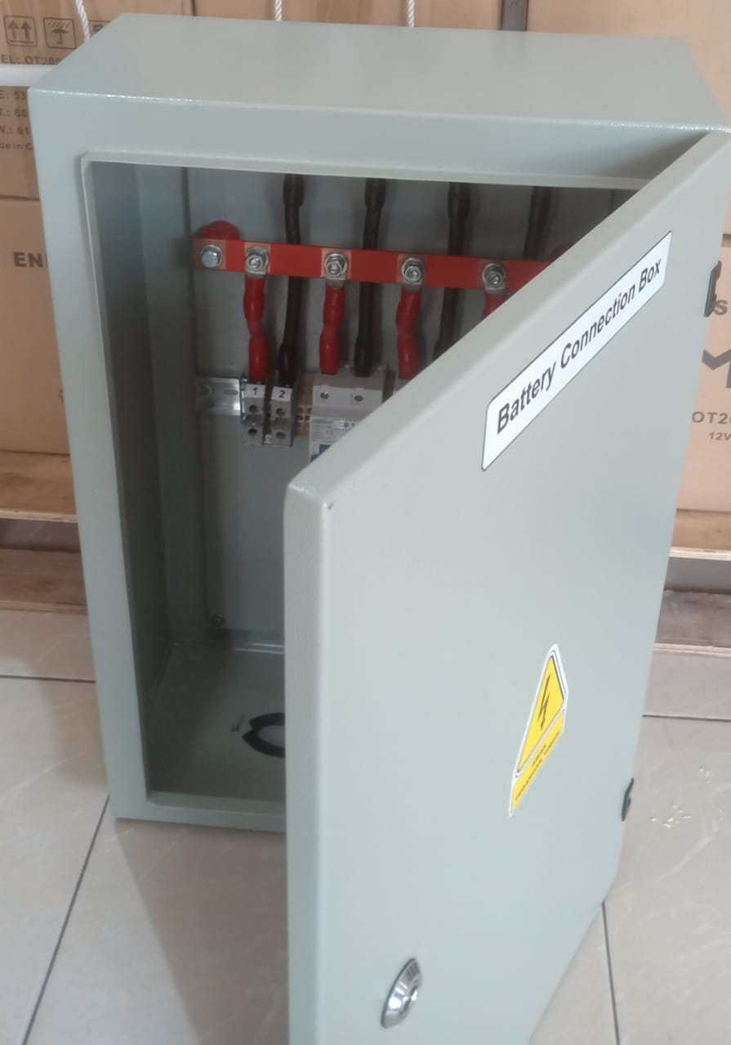
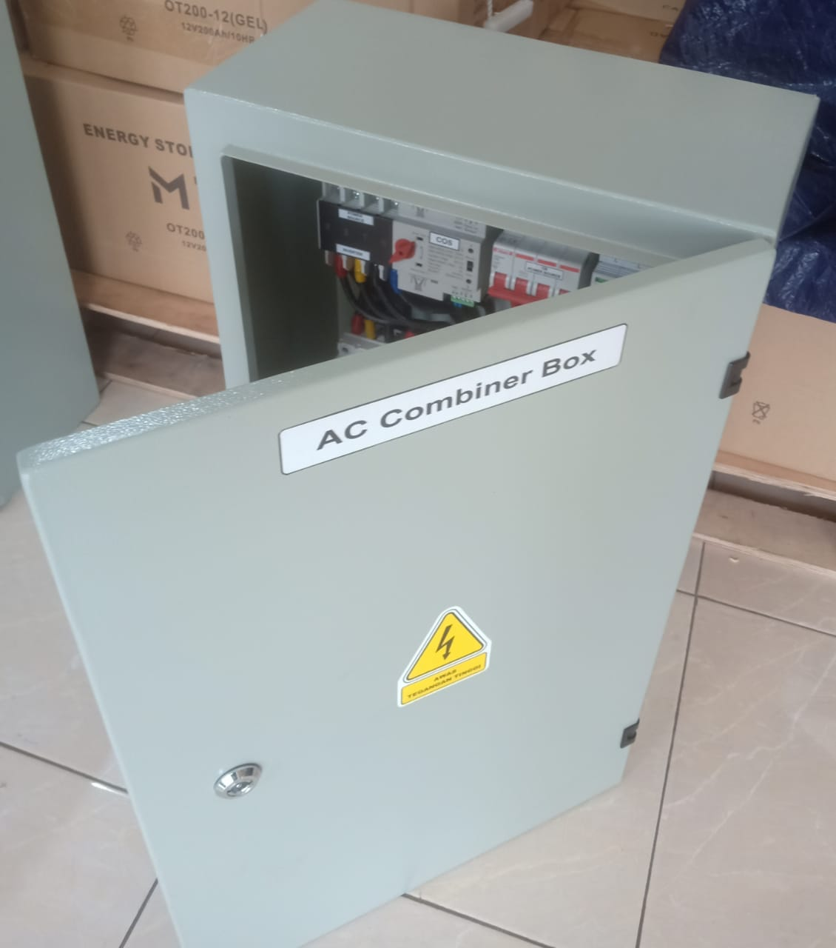
OUR PORTOFOLIO
Produksi Panel Box + Wirring

Slide 25
OUR PORTOFOLIO
Lokasi :
Desa Buluh Merindu
Desa Buluk Jegara
Desa Lalang Ingar
Desa Melingkat
Desa Mengkirai
Desa Pakak
Desa Sungai Buaya
Desa Sungai Sintang
Desa Tanjung Putar
Desa Tertung Mau
BTS Erection and Power – Kalimantan Tengah

Slide 26
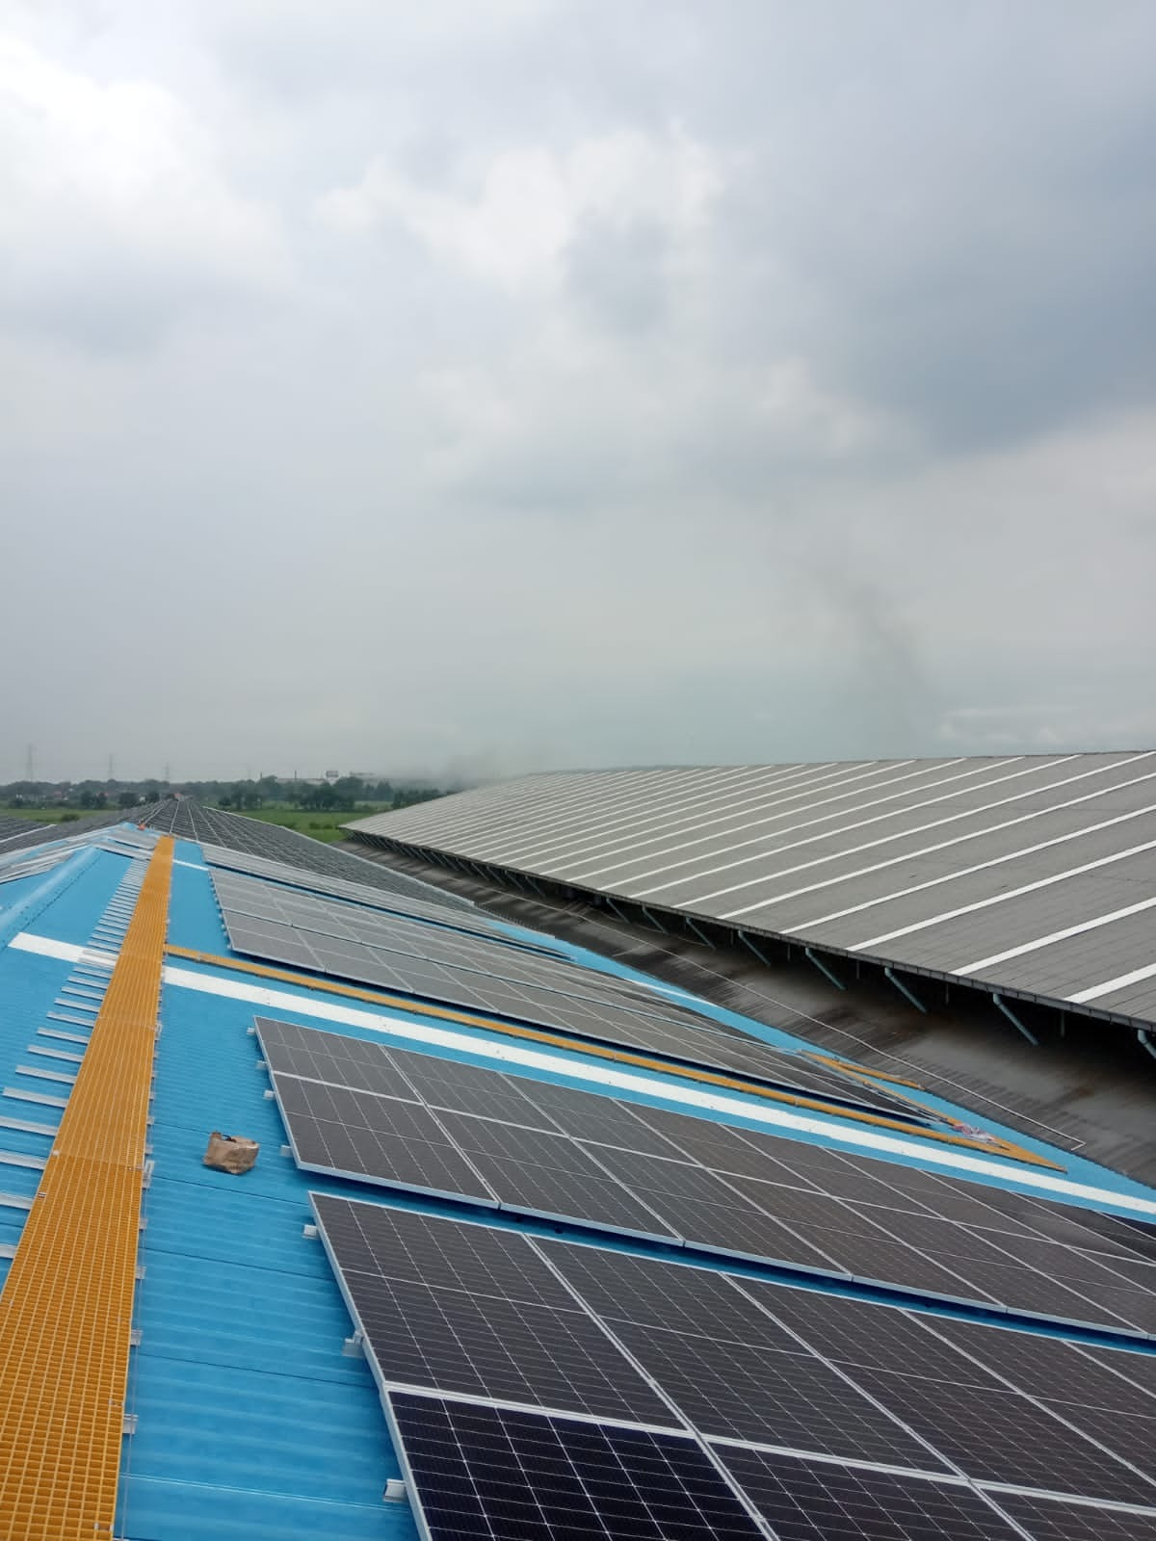
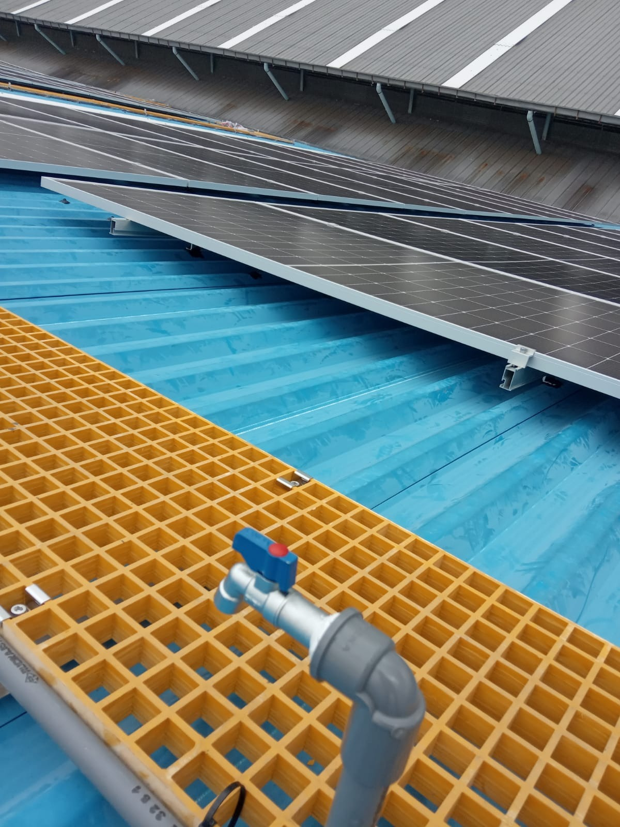
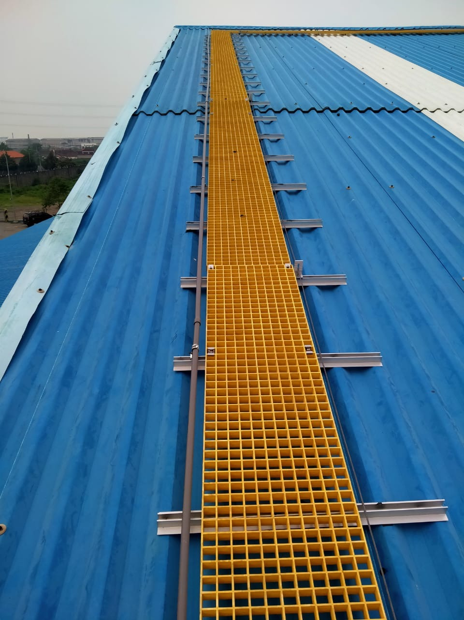
Our PortFolio
2 MWp Bogor
Jawa Barat

Slide 27
Want big impact?
USE BIG BREAKTHROUGH

Slide 28
THANKS!
Any questions?
You can find me at
Instagram @gosuryaenergi
Email : koko.antonio@gosurya.co.id

